Slide 1

Image classification
Comparing Optimal Transport-based and Traditional Manifold Learning Algorithms

Slide 2
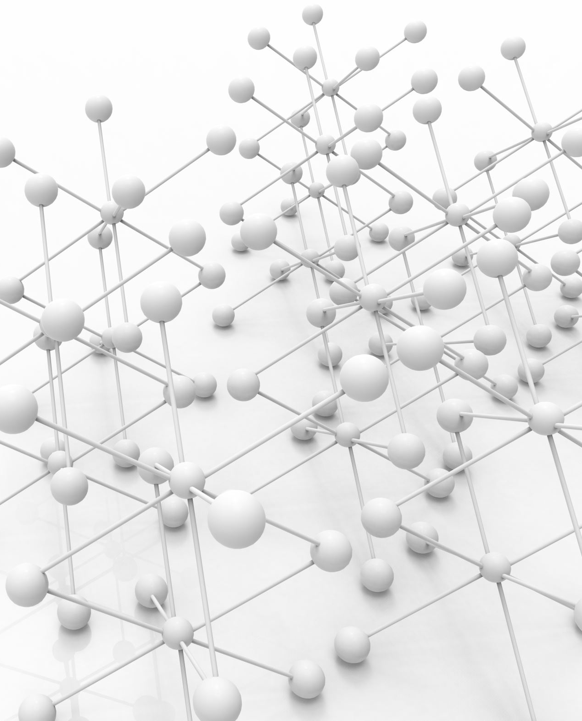
Manifold Learning
Manifold learning uncovers low-dimensional structures hidden in high-dimensional data, ideal for complex datasets where direct analysis is impractical.
It preserves crucial geometric relationships, essential for tasks like visualization and feature extraction, enhancing the performance of supervised learning by simplifying data complexity.

Slide 3

FASHION MNIST

Slide 4
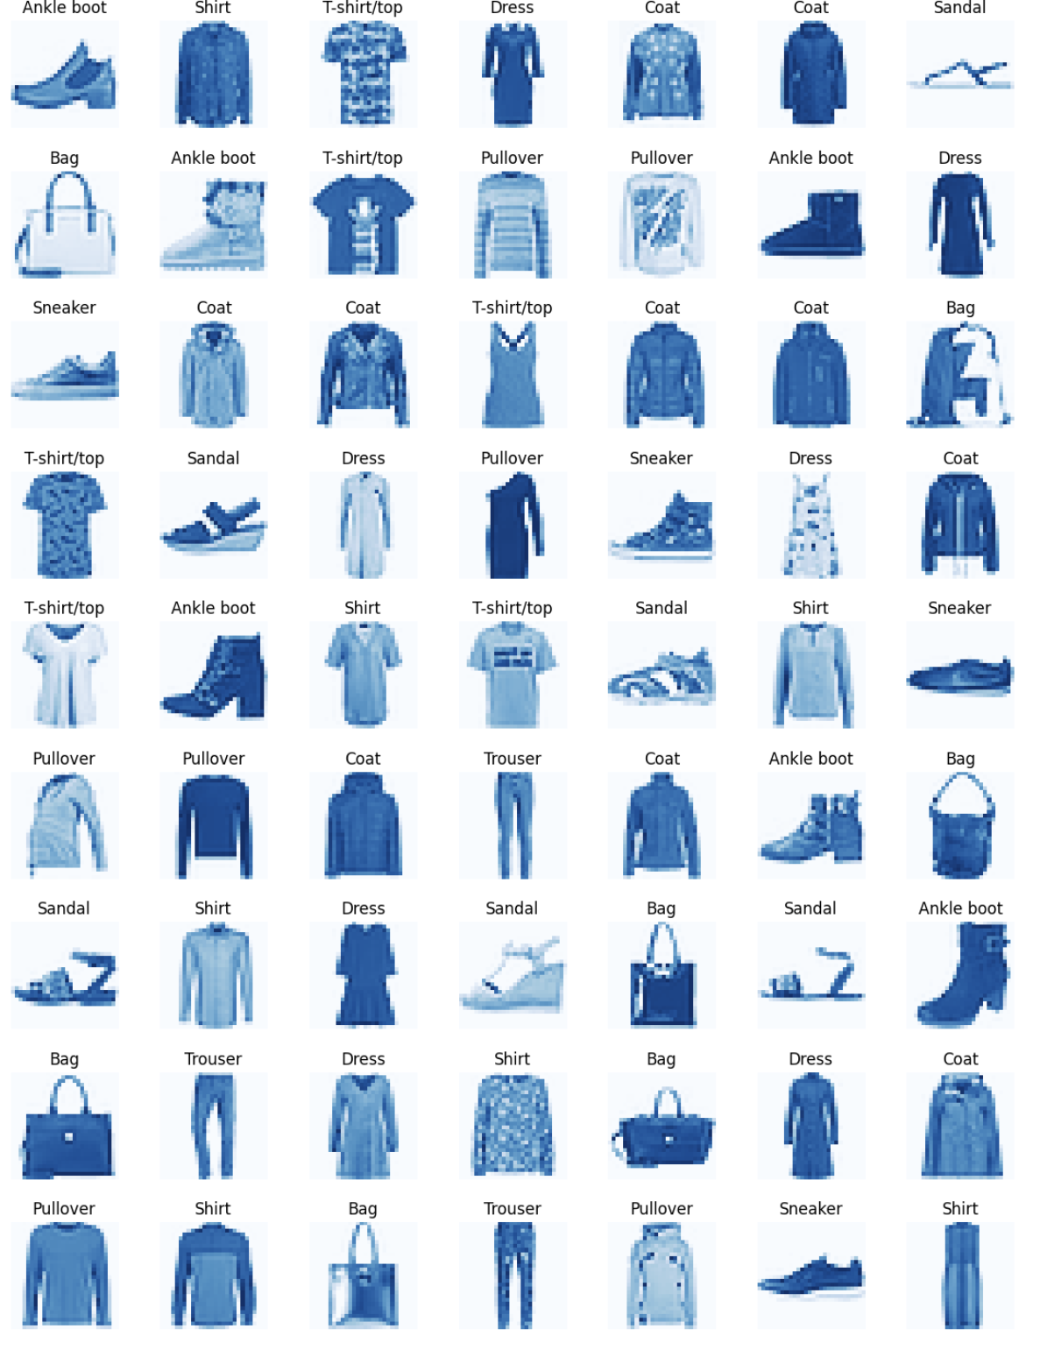
Dataset
Images of clothing items (
Array (typically used with libraries like TensorFlow and Keras).
28x28 grayscale images.
Data points of 70,000 images (60,000 for training and 10,000 for testing).
There are 10 classes.
Type of classes is a label (such as "T-shirt/top", "Trouser", "Pullover", etc.).
Data points in each classes:
7,000 images per class (6,000 for training and 1,000 for testing).

Slide 5
Data Preprocessing
None required.
The dataset is already preprocessed for convenience.
Images are normalized to have pixel values between 0 and 1 when used in most deep learning frameworks.

Slide 6
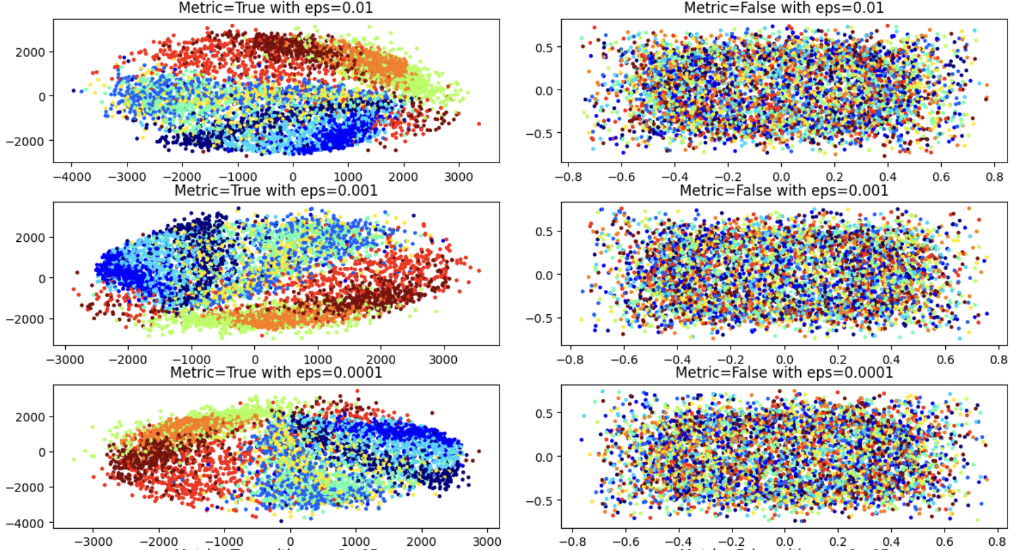
Multidimensional Scaling MDS
Metric MDS: Keeps true distances, directly mapping the relationships from high-dimensional data to 2D space.
Non-metric MDS: Preserves the order of distances, focusing on the relative positioning rather than exact distances.
Clusters Visualization: Displays groups of similar fashion items, highlighting patterns and relationships in the dataset.

Slide 7
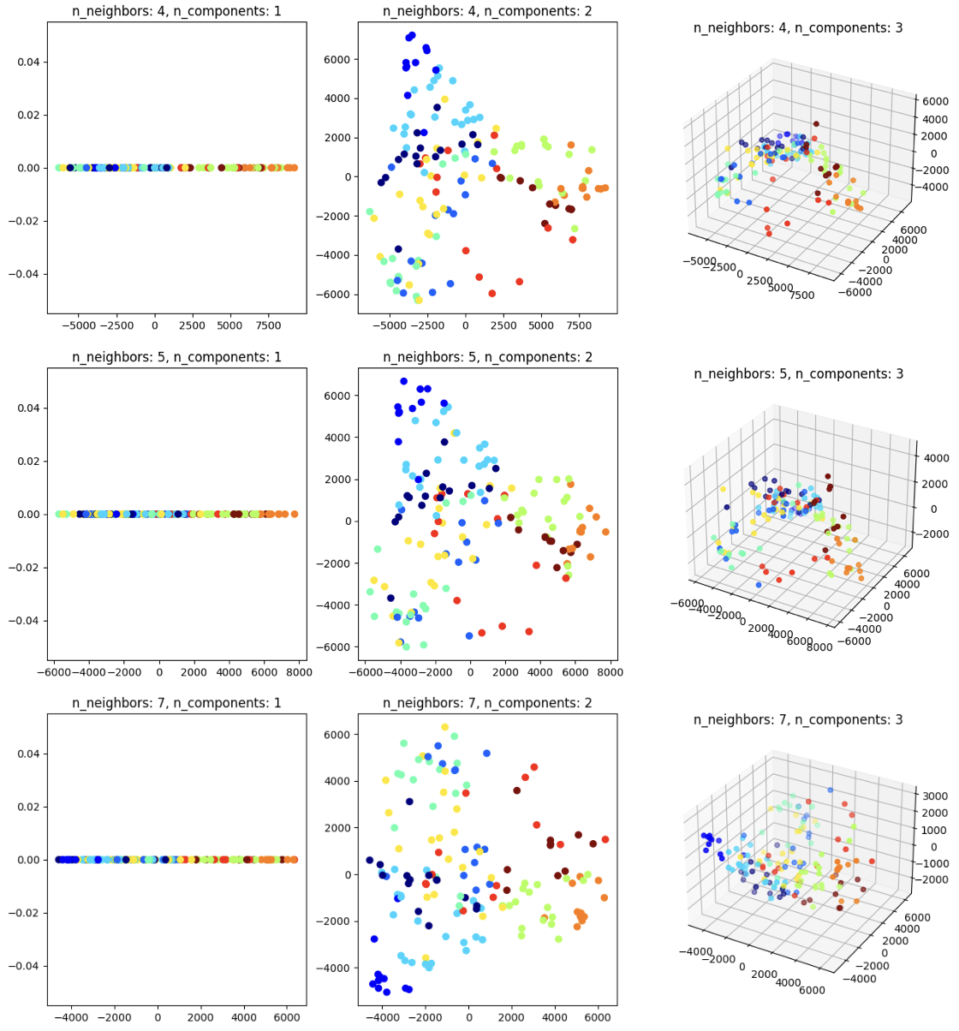
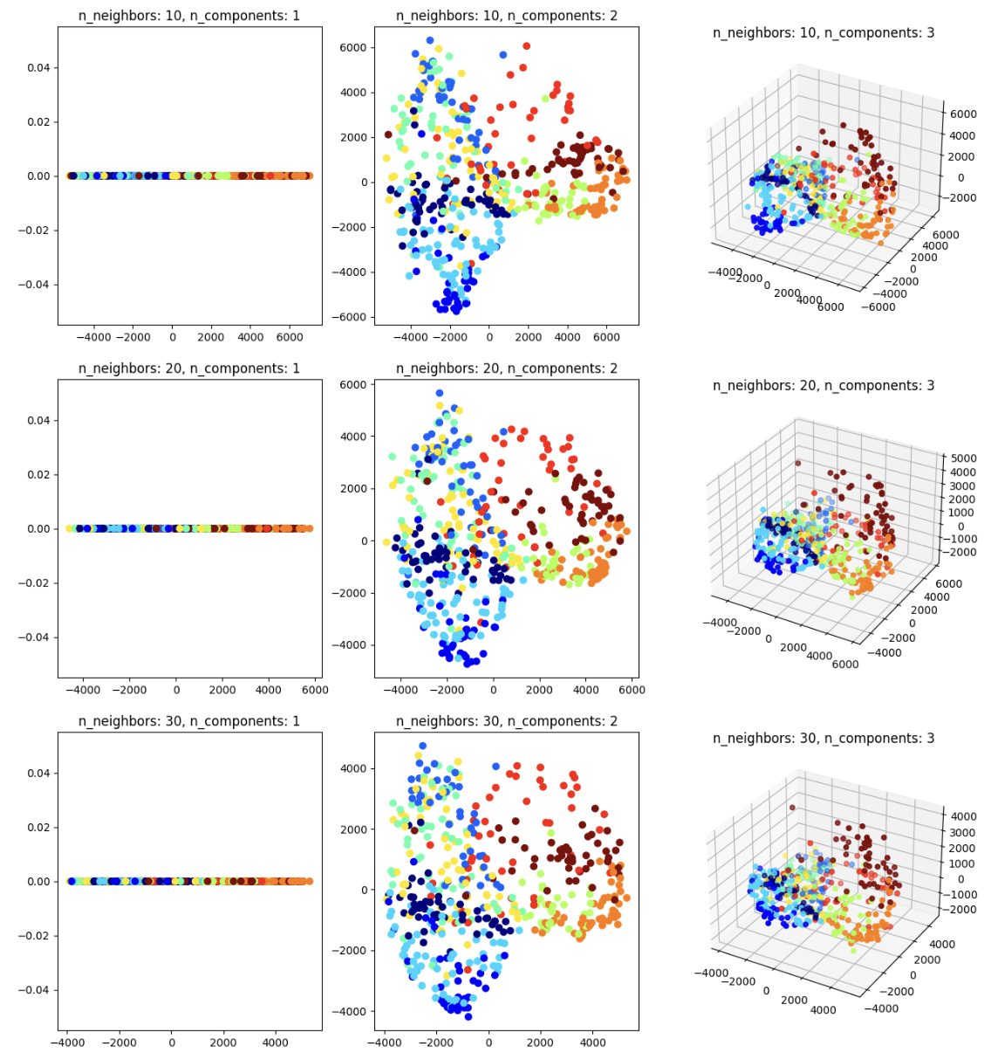
ISO MAP
IsoMap Parameters:
Number of Neighbors (n_neighbors): Ranges from 4 to 30, determining the local neighborhood around each data point. A higher value considers more neighbors for a global view, while a lower value focuses on a local perspective.
Number of Components (n_components): Set to 2 or 3, indicating the dimensionality of the embedding space. Two components simplify the complexity, while three components offer a deeper insight into the data structure.
Visual Analysis of Embeddings:
2D Embeddings: These plots show clear clusters, reflecting similarities among fashion items. It's easier to discern patterns and groupings in a 2D layout.
3D Embeddings: Offer a more nuanced distinction between clusters. Although they provide a detailed structure of the dataset, they require more complex interpretation.
Clusters Observation:
The clusters in the visualization may show some overlap, which suggests that the grayscale pixel data of Fashion MNIST does not always provide stark distinctions between different fashion items. Overlaps could be attributed to similarities in textures, shapes, or styles inherent to the dataset.

Slide 8
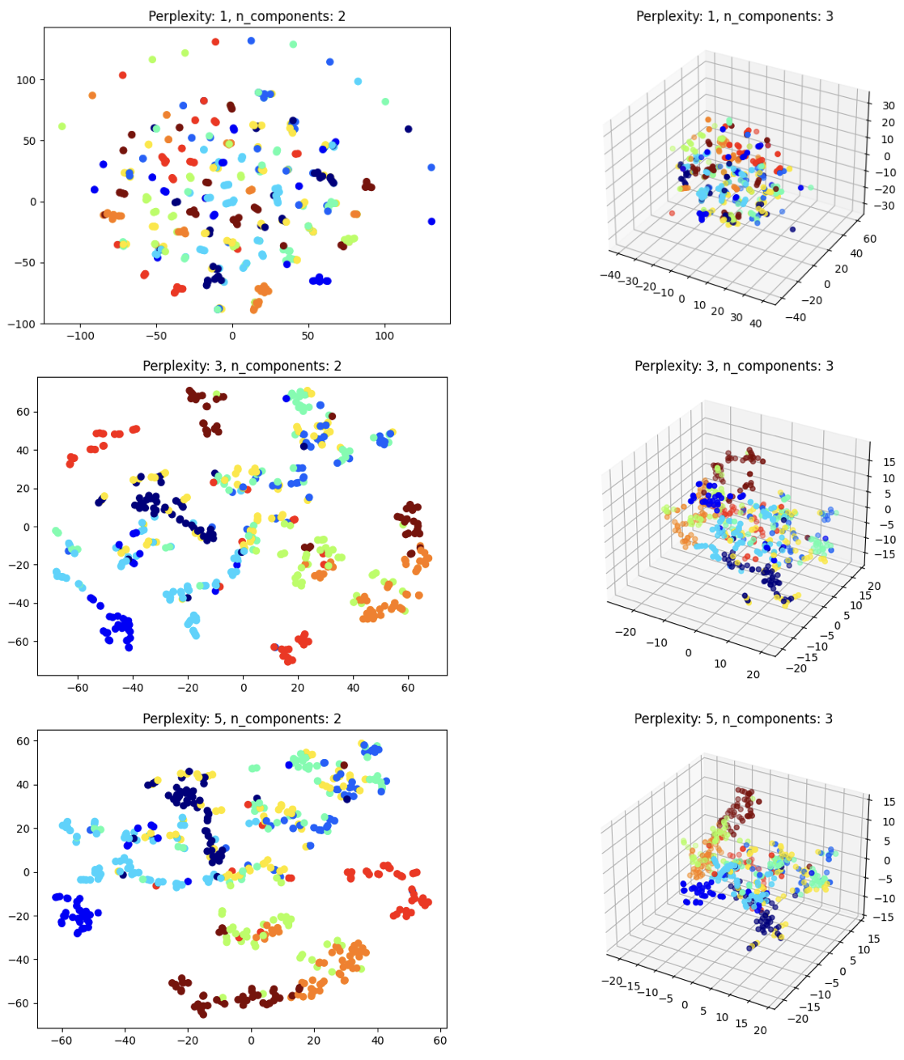
T-SNE
t-SNE Parameters:
Perplexity Range: Adjusted from 1 to 5. This parameter balances attention between local and global aspects of data, with lower values focusing on local data clusters and higher values on broader data trends.
Number of Components: Set to either 2 or 3, to project the high-dimensional data into a 2D or 3D space for visualization.
Embedding Insights:
2D t-SNE Embeddings: Offer a simplified view that highlights distinct clusters of fashion items, useful for identifying patterns and similarities.
3D t-SNE Embeddings: Provide a more comprehensive perspective of the data structure, revealing complex relationships between items with increased detail.
Cluster Interpretation:
In the visualizations, clusters may exhibit varying degrees of overlap, indicating that some fashion items share characteristics that are not distinctly separated by pixel-level features. This suggests a nuanced similarity among certain fashion categories within the dataset.

Slide 9
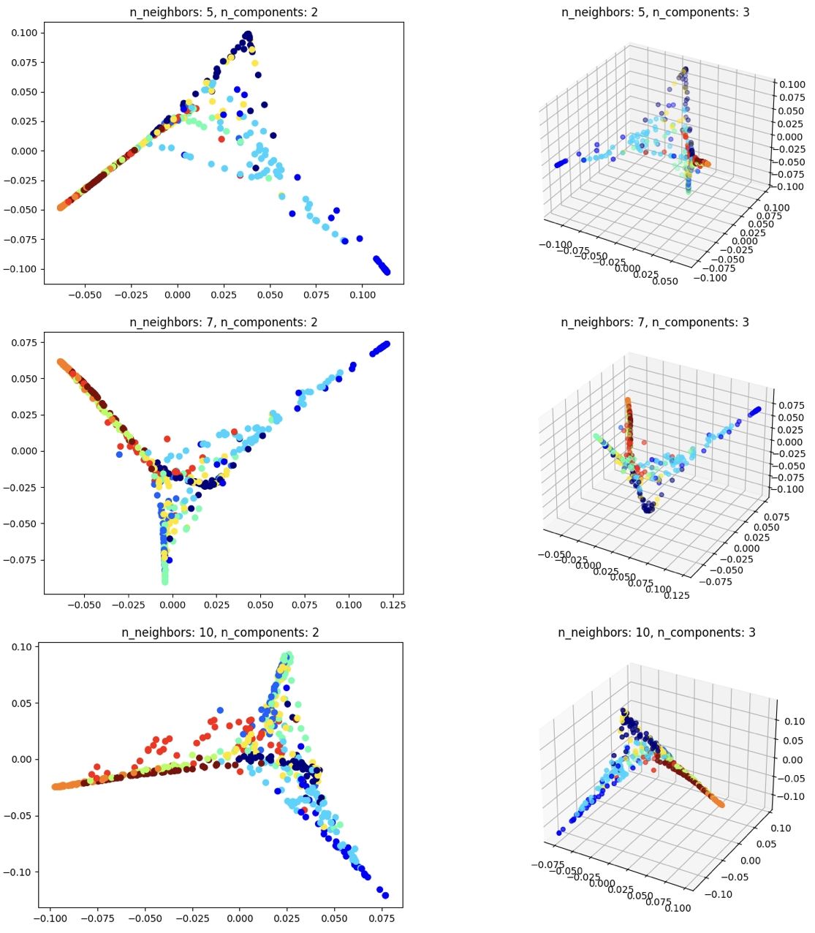
Locally Linear Embeddings
n_neighbors=5: Shows initial cluster formations with some overlap in both 2D and 3D, suggesting that local similarities among fashion items are beginning to be captured.
n_neighbors=7: Reveals more defined structures, with clearer clusters in 2D and a discernible, curving manifold in 3D, indicating more complex item relationships.
n_neighbors=10: Exhibits the most distinct clusters, especially in 3D, with a smoother manifold that implies a deeper understanding of the dataset's geometry.
Clusters:
Increasing n_neighbors gradually uncovers the manifold's complexity and the inter-item relationships within the Fashion MNIST dataset, moving from simple groupings to intricate geometric forms.
Notes:
This analysis interprets the effect of varying n_neighbors on the visualization of the Fashion MNIST dataset, revealing how the relationships between fashion items are expressed in the embedded space.

Slide 10
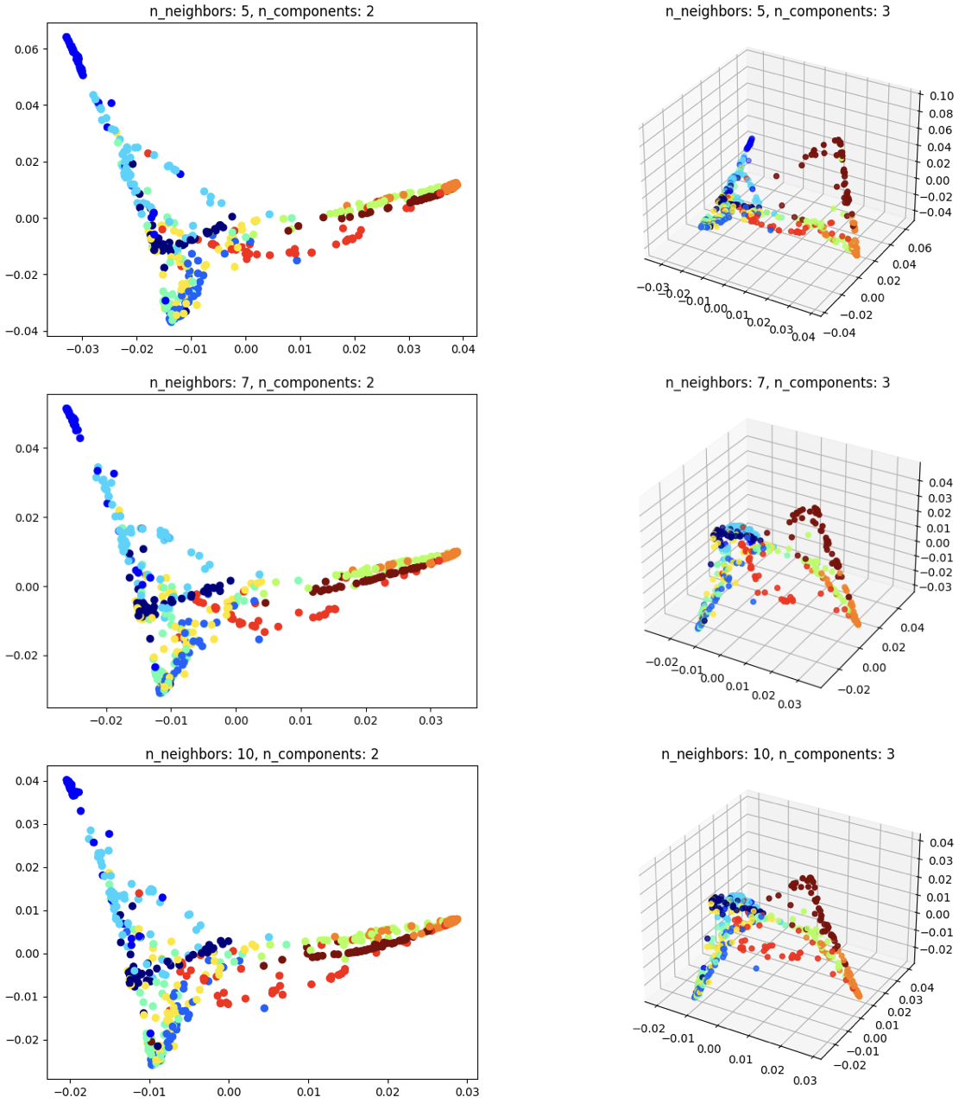
Spectral Embeddings
n_neighbors=5: Emerging clusters in 2D and 3D indicate the beginning of a discernible data structure within the fashion items.
n_neighbors=7: Improved cluster definition in both visualizations suggests clearer relationships between items, highlighting a more complex manifold.
n_neighbors=10: Sharper, well-defined clusters and a smoother manifold surface in 2D and 3D plots reveal the intricate nature of the dataset.
Cluster:
The visual clusters display the similarities and differences within the fashion items, where the varying density and overlap of points can reveal underlying patterns in the dataset.
Increasing n_neighbors incrementally uncovers the manifold's complexity, showing how fashion items are related in a multi-dimensional space.
Notes:
This analysis suggests that as the number of neighbors increases, the Spectral Embedding becomes more adept at revealing the subtle complexities within the Fashion MNIST dataset.

Slide 11
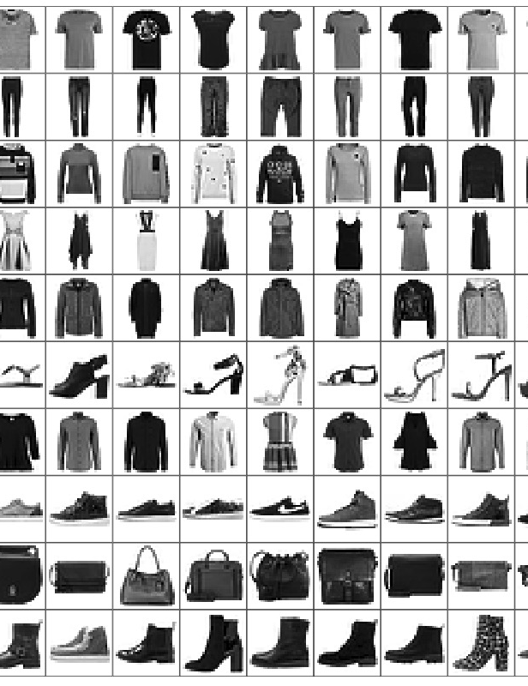
Comparison in embeddings
Similarities:
All methods strive to uncover the underlying structure of the Fashion MNIST dataset.
Overlapping clusters appear across different techniques, indicating that some fashion items share subtle features that are challenging to distinguish solely based on pixel data.
Differences:
Multidimensional Scaling (MDS): Provides a direct translation of distances in metric MDS or preserves the rank order in non-metric MDS, reflecting either precise distances or relative similarities between items.
IsoMap: Aims to maintain geodesic distances within local neighborhoods, unfolding the manifold in a way that preserves the true shape of the Fashion MNIST data.
t-SNE: Adjusts the balance between local and global data structures dynamically with perplexity, revealing clusters in a way that emphasizes both individual item similarities and overarching dataset patterns.
Locally Linear Embedding (LLE): Focuses on preserving the local angles and distances, potentially revealing intricate local geometrical structures of the fashion items.
Spectral Embedding: Operates by preserving neighborhood relationships through graph distances, which may highlight local clustering with a different perspective compared to LLE, particularly noticeable as n_neighbors increases.

Slide 12
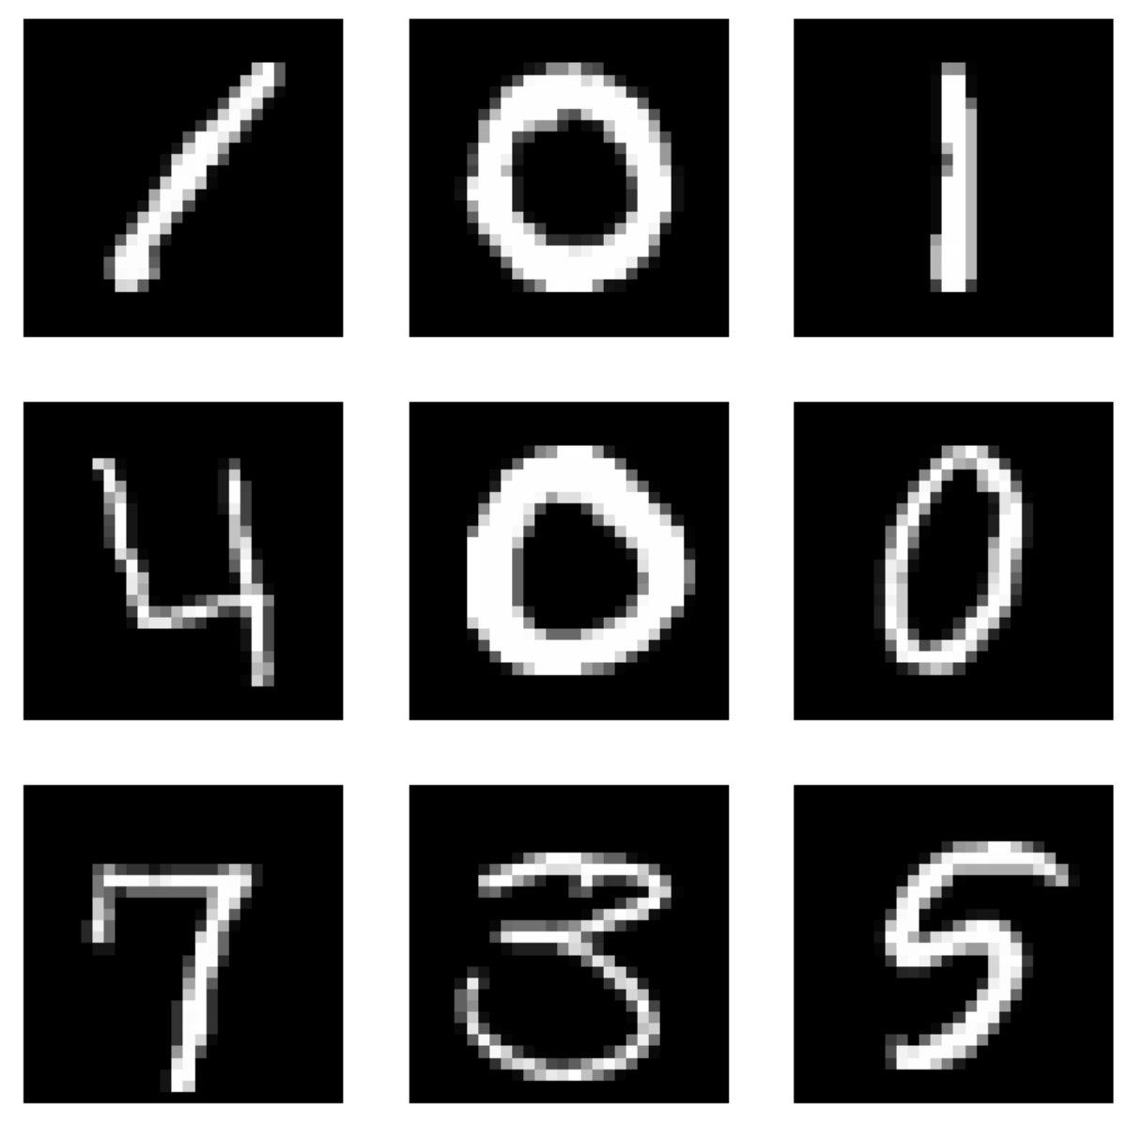
Digital-Handwritten-MNIST

Slide 13
Dataset
Handwritten digit images.
Format: Grayscale images, typically in array format.
Uniform 28x28 pixels.
Total Data Points: 70,000 images (60,000 for training, 10,000 for testing).
10 classes (digits 0 through 9).
Type of Classes: Numerical labels representing the digit value.
Points per Class: Approximately 7,000 images per class.

Slide 14

Data processing
None required
Data already converted to grayscale images also the size of 28x28
Pixel values scaled from 0-255 to 0-1 to aid in learning process.
Images converted from 2D array (28x28) to 1D array (784) for certain algorithms.

Slide 15
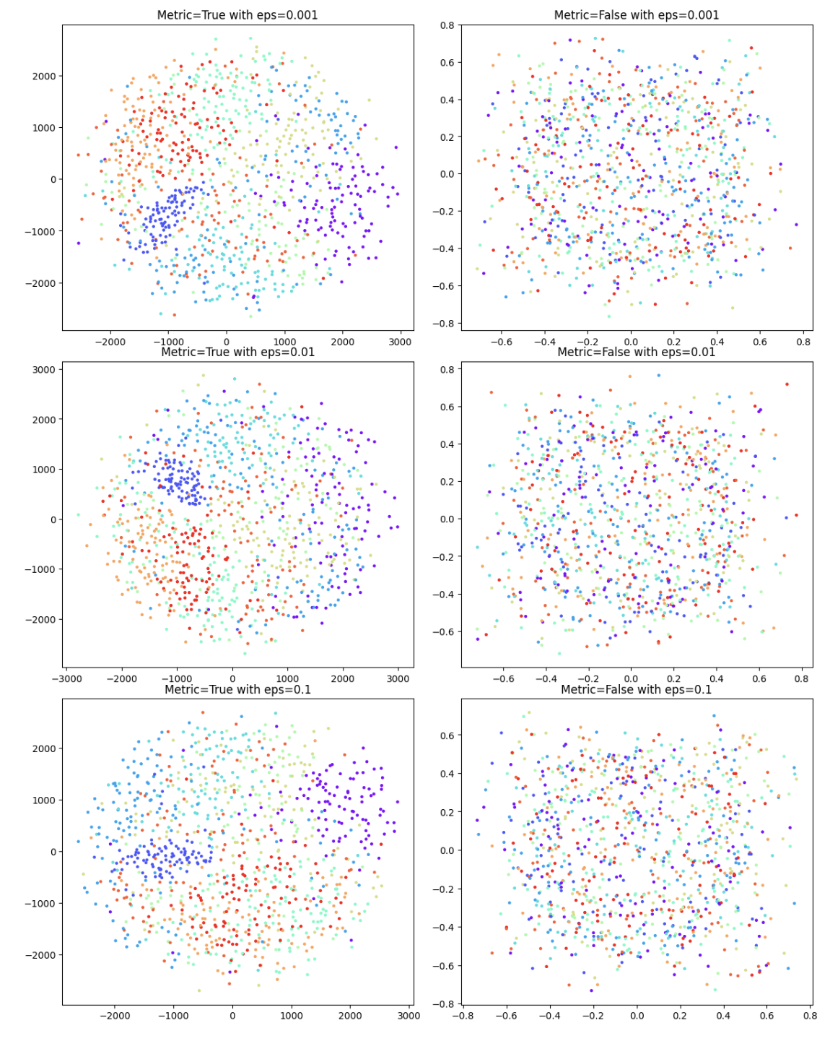
MDS

Slide 16
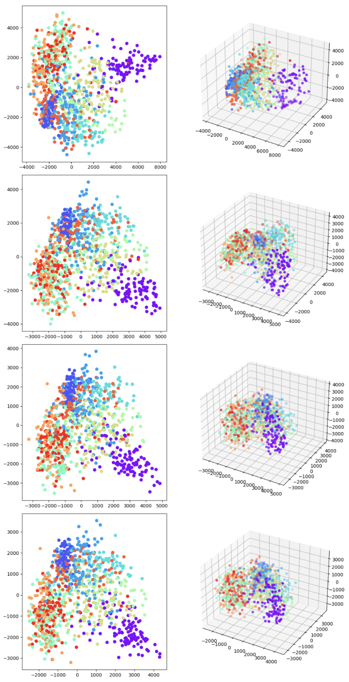
ISO-Map

Slide 17
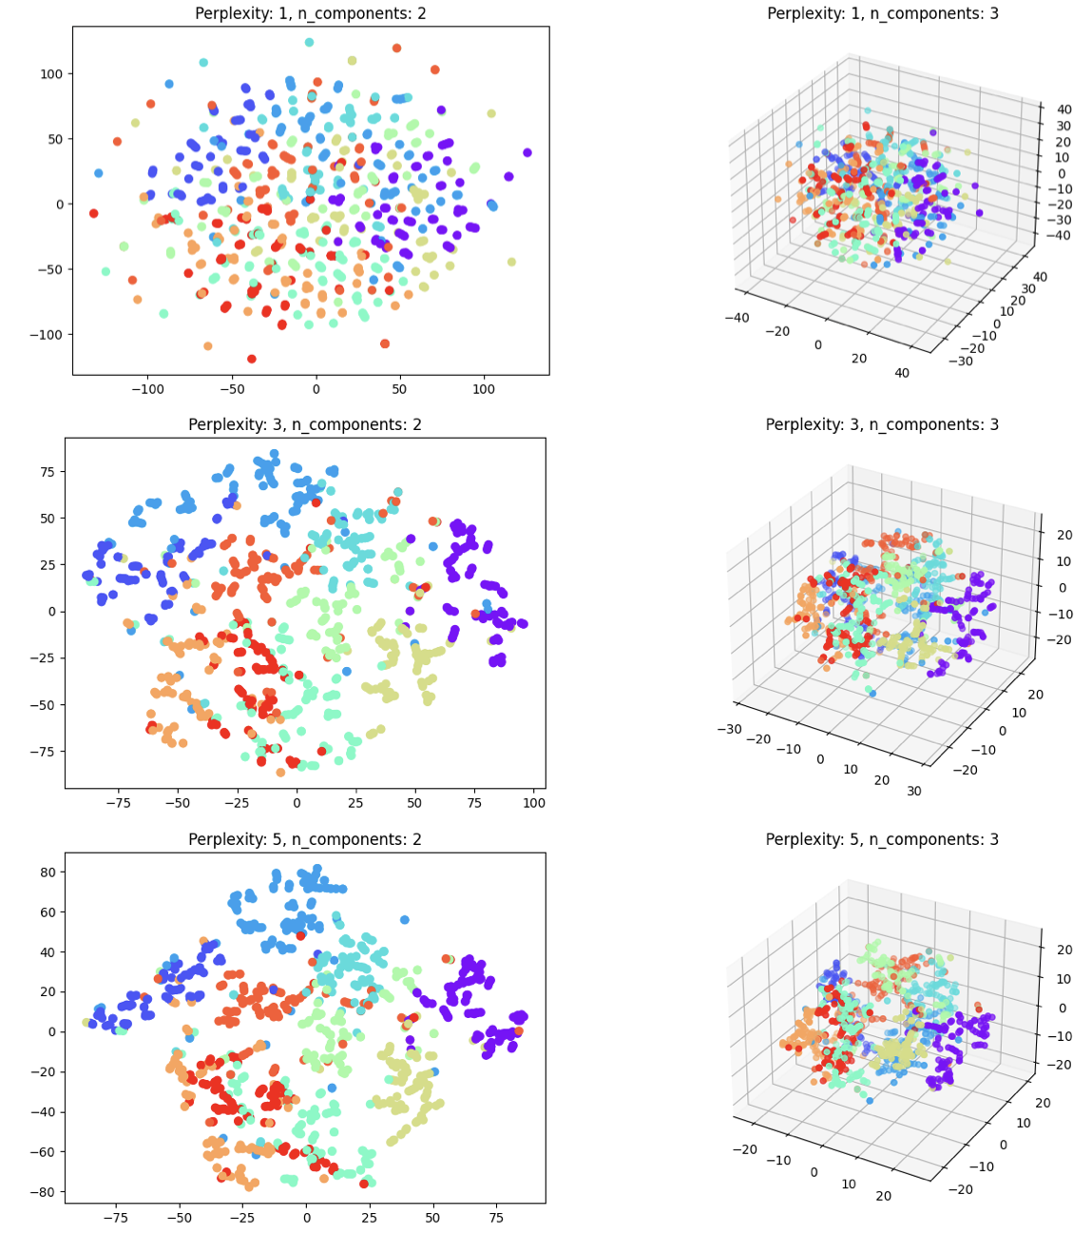
t-SNE

Slide 18
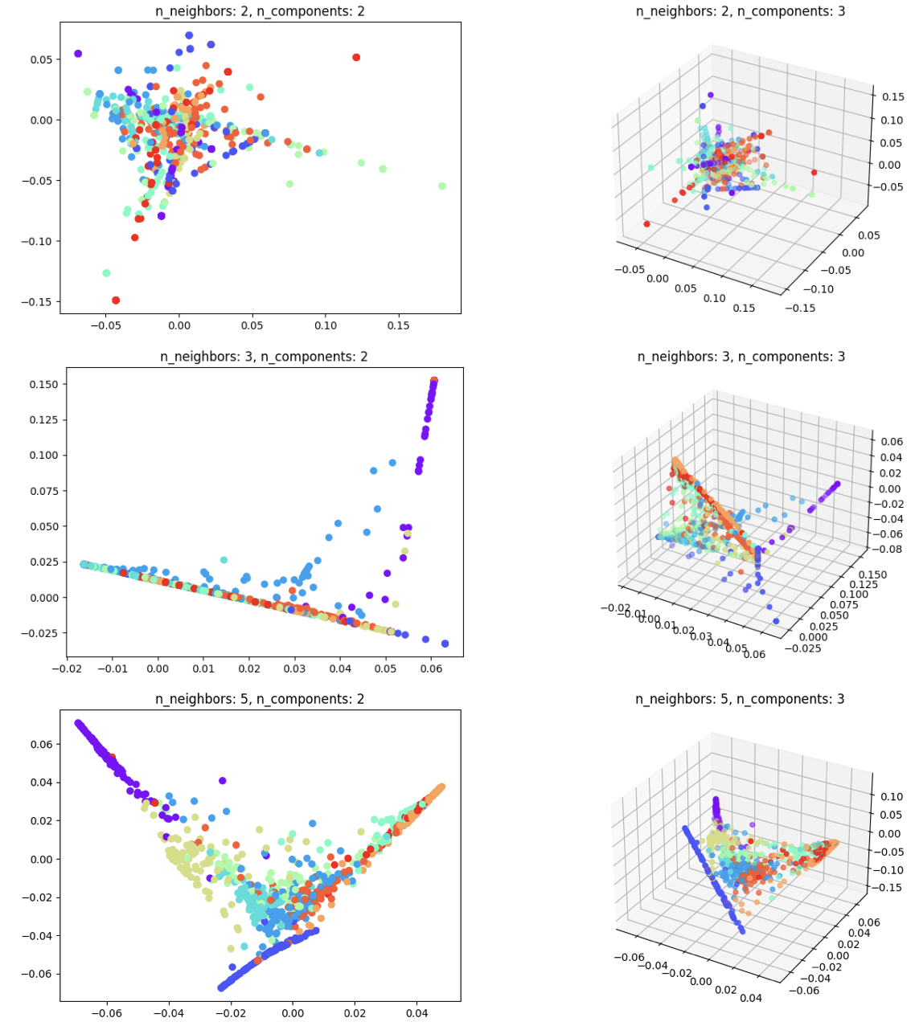
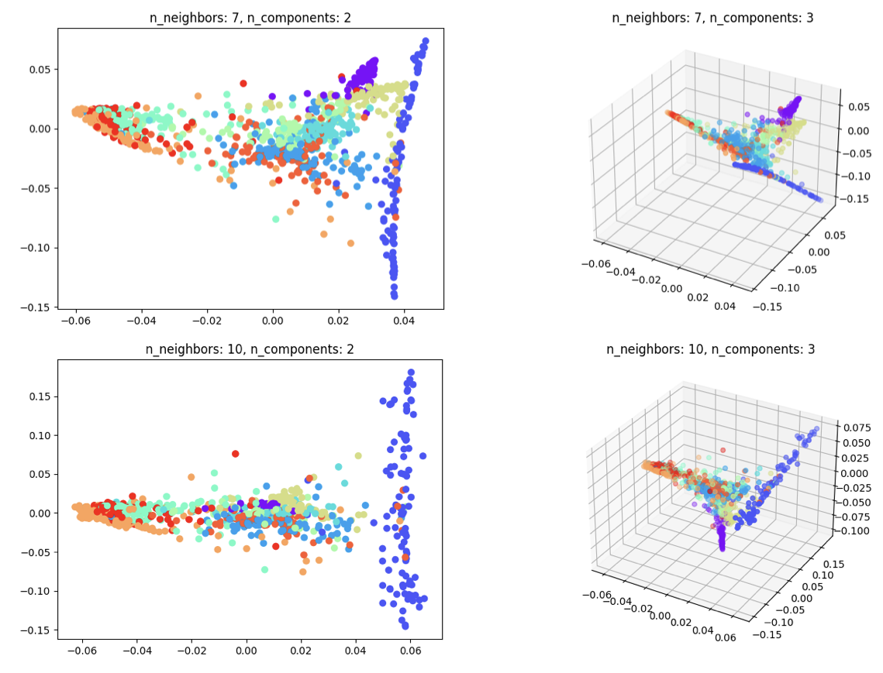
Locally Linear Embedding

Slide 19
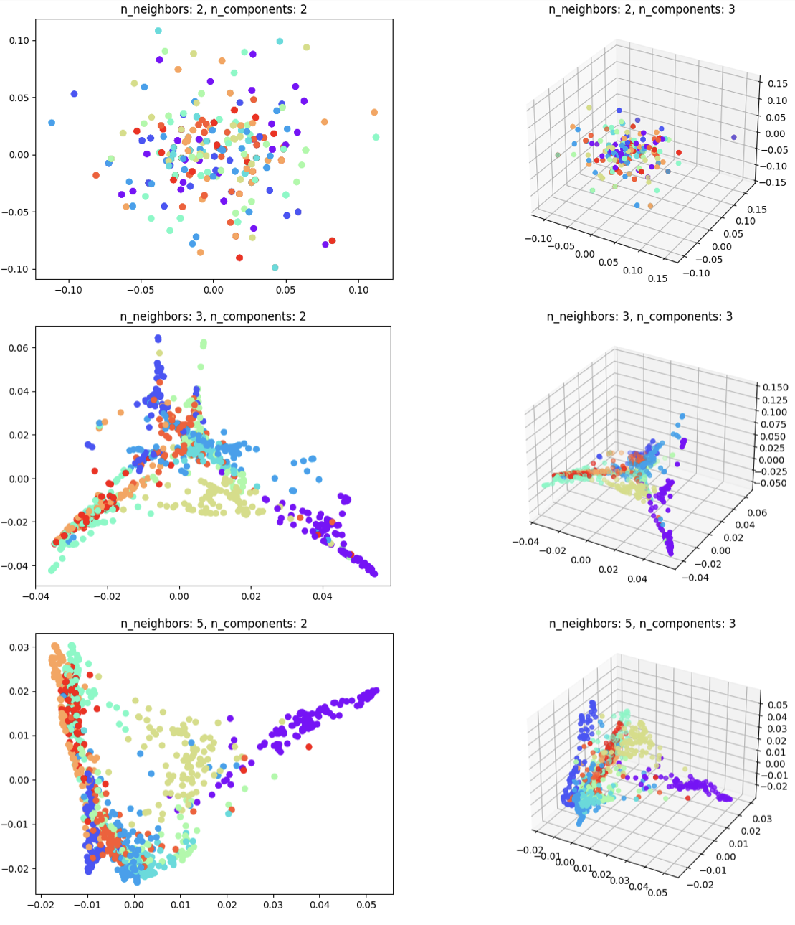
Spectral Embedding

Slide 20
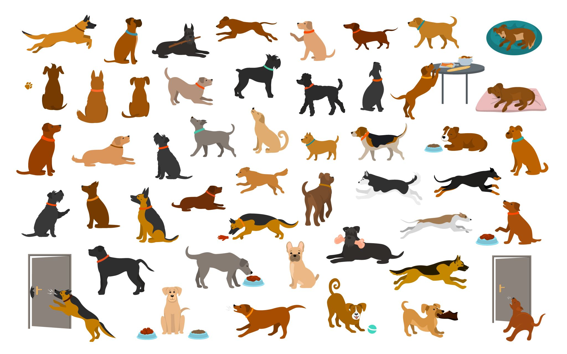
DOG BREED CLASSIFICATION Dataset

Slide 21
Dataset
The data consists of images segmented into various dog breed folders.
The images are in ‘.jpg’ format.
There are total of 541 images across all classes and distinct into 8 dog breed classes in dataset. Each class is label representing a specific dog breed.
Data points in each class:
Rottweiler: 78 images
Dalmatian: 51 images
German-Shepherd: 76 images
Beagle: 83 images
Husky: 71 images
Poodle: 56 images
Bulldog: 76 images
Labrador-Retriever: 50 images

Slide 22
Data preprocessing
All images had different size before processing.
The image were converted to grayscale and resized to a uniform size of 224x224*(average size). This processing is commonly done to standardize the input for deep learning models and to simplify computations. The requirement is should be the same dimension.
Various manifold learning techniques were applied, such as MDS, ISOmap, t-SNE, Locally Linear Embedding, and Spectral Embedding.
Notes:
This processing is commonly done to standardize the input for deep learning models and to simplify computations.
These techniques are used to visualize and explore the high dimensional data in lower-dimensional spaces, which can aid in understanding the relationships between different data points or classes

Slide 23
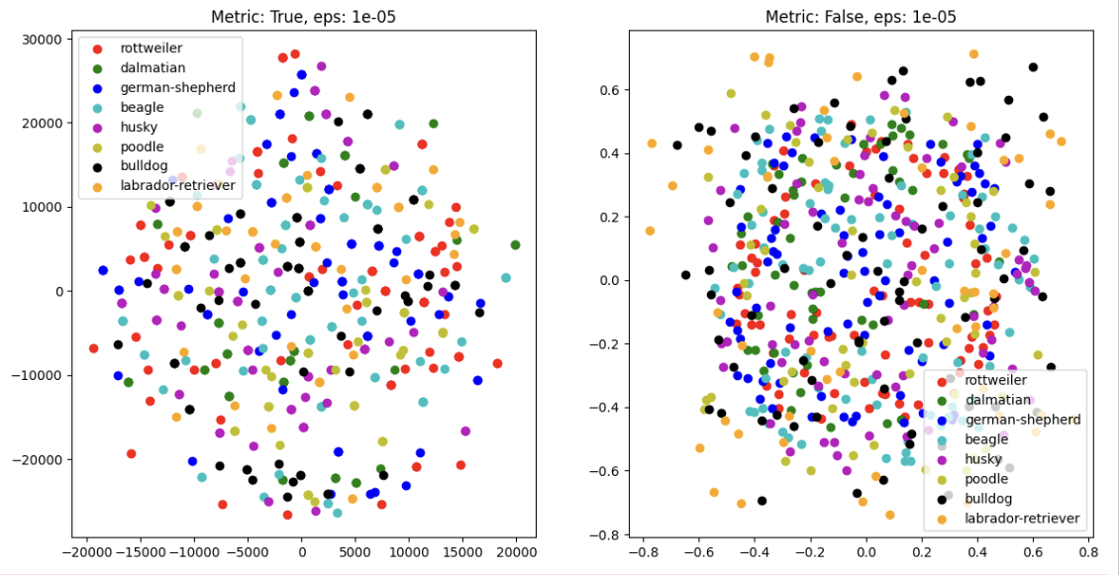
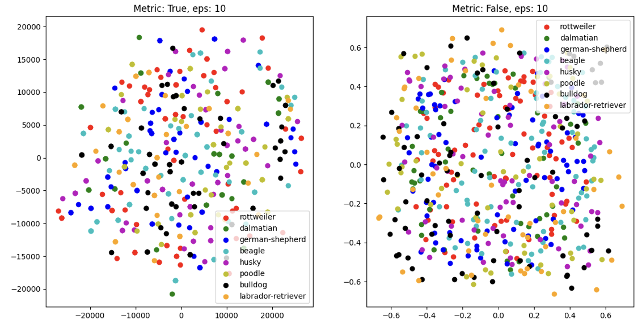
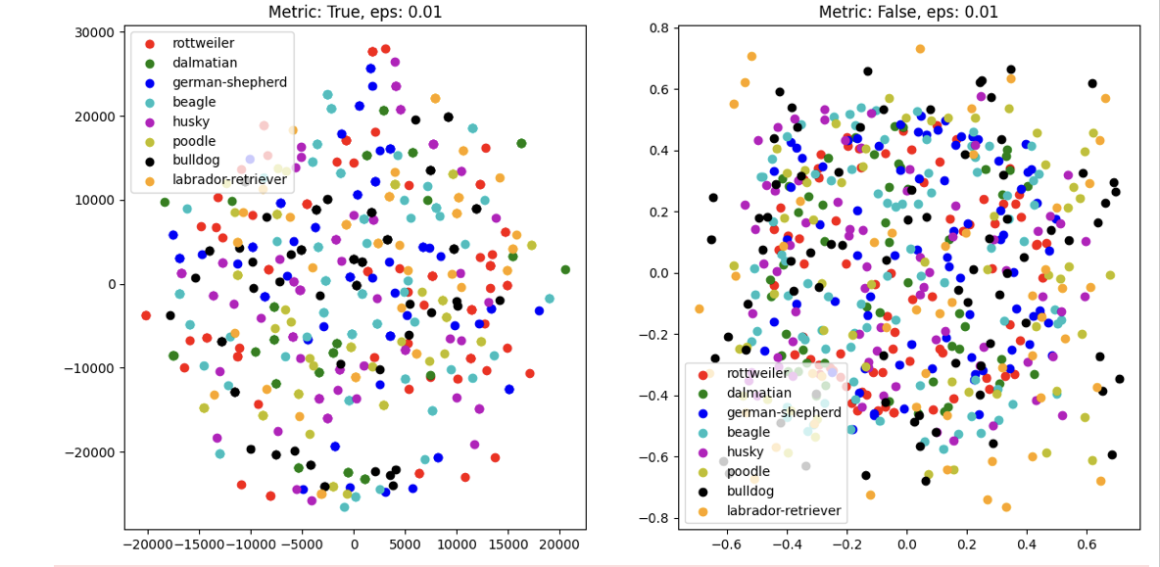
Multidimensional Scaling (MDS)
MDS Types:
Metric MDS (True): Preserves the actual distances between breeds. Represents direct translations of relationships from the original space to the visual space.
Non-metric MDS (False): Maintains the rank order of distances. Ideal for capturing relative relationships without sticking to exact original distances.
Clusters:
Clusters represent groups of dog breeds that are similar in certain attributes.
Notes:
Factors influencing clustering:
Lineage: Ancestry or descent of breeds. Breeds with shared ancestries might cluster closer.
Appearance: Physical characteristics such as size, fur type, and color. Similar-looking breeds cluster together.
History: Origin and purpose behind the breed. Breeds from similar regions or with similar functions are likely to be nearby.

Slide 24
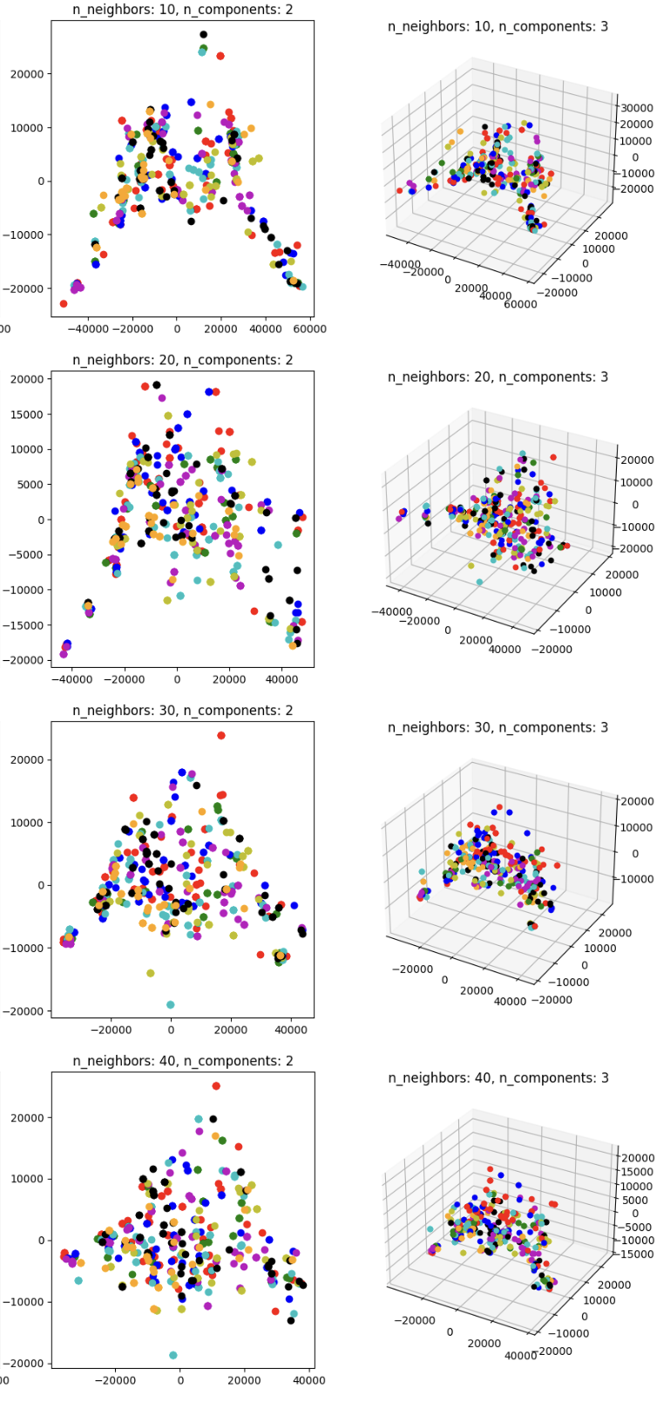
ISO Map
IsoMap Parameters:
n_neighbors: Range 10 to 40. Controls how IsoMap defines the 'neighborhood' of each point.
n_components: 2 and 3. Represents the number of dimensions in the transformed space.
Visual Insights:
#2D plots clearer clusters, suggesting breed similarities.
3D plots provide the most distinct groupings but are more complex to analyze.
Clusters:
Show overlapping clusters, suggesting that pixel-level data of dog breeds in grayscale does not provide enough distinction. This overlap may result from commonalities in breed images, such as shared patterns due to backgrounds or poses.
Dimensionality Limitations:
Low-dimensional embeddings struggle to differentiate breeds, implying that key breed-specific variations are lost in these reductions. While 3D representations improve separation slightly, the distinction between breeds remains subtle, hinting at the complex nature of breed characteristics that are beyond just pixel-level differences.
Notes:
Iso map is an important technique for dimensionality reduction in machine learning and data visualization.
Increasing n_neighbors typically smoothens the embedding, potentially merging distinct groups.
Higher n_components capture more data structure, but interpretation becomes harder.
Visible clusters in 2D and 3D may correspond to genetic or phenotypic similarities among breeds.

Slide 25
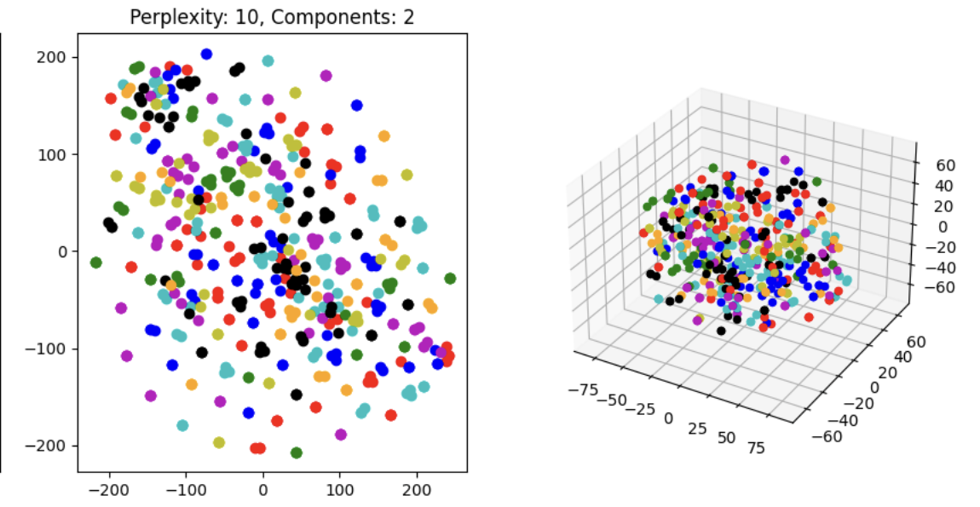
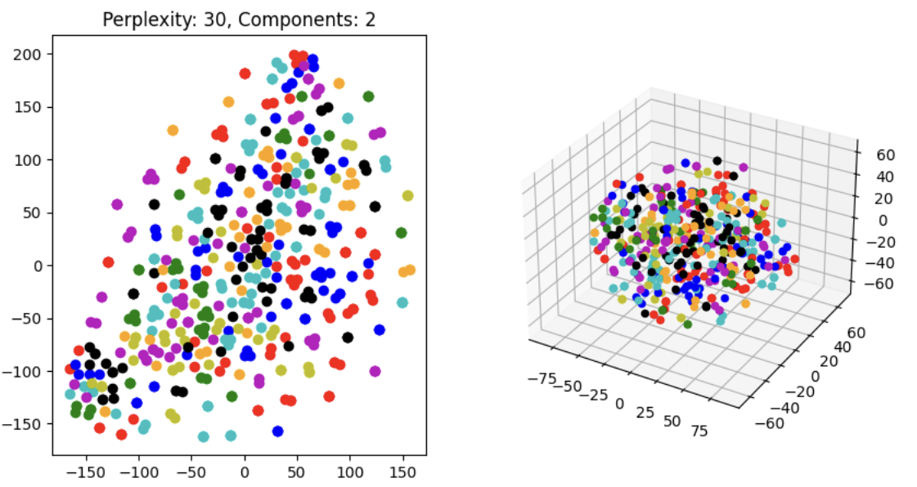
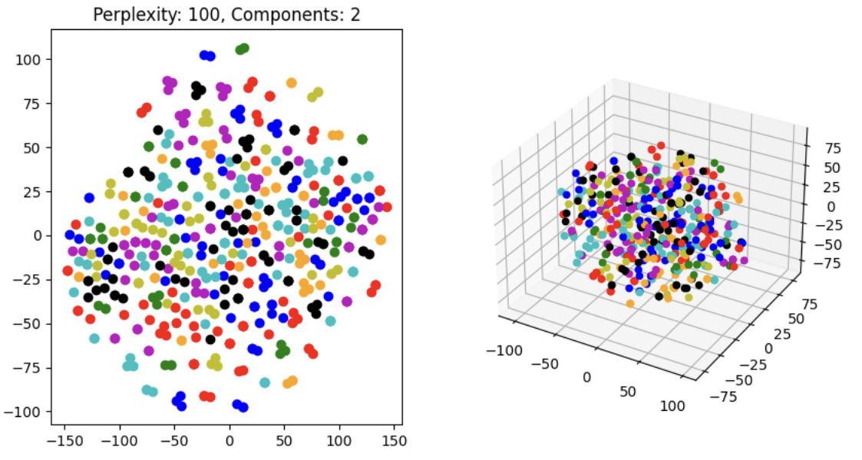
t-SNE
Parameter: show in different settings of 10, 30 and 100. It influences the balance between local and global aspects of the data. Low perplexity highlight local structure, while high perplexity captures more global relationships
Clusters: t-SNE offers a more visually distinct separation, the overlap still persists
Notes:
T-sne: advanced manifold learning techniques but it still struggle to perfectly segregate highly similar and nuanced data
Perplexity in t-sne helps the algorithms decide how much it should pay attention of groups of nearby points vs the bigger picture.

Slide 26
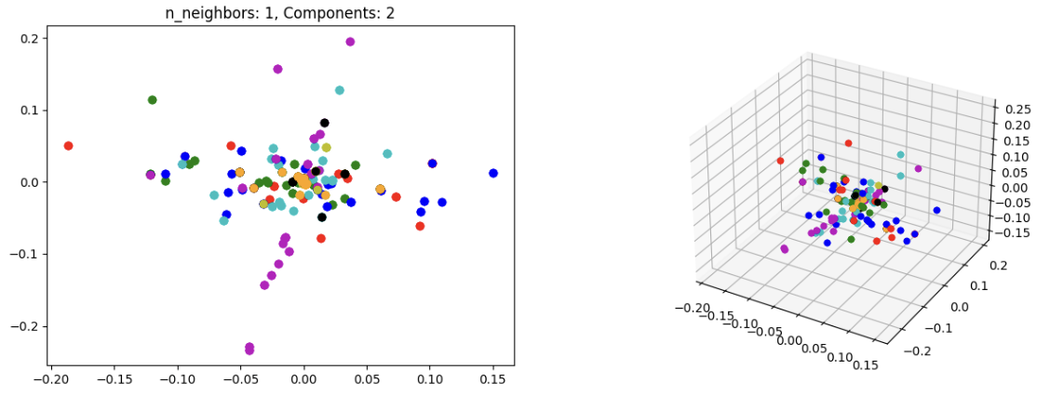
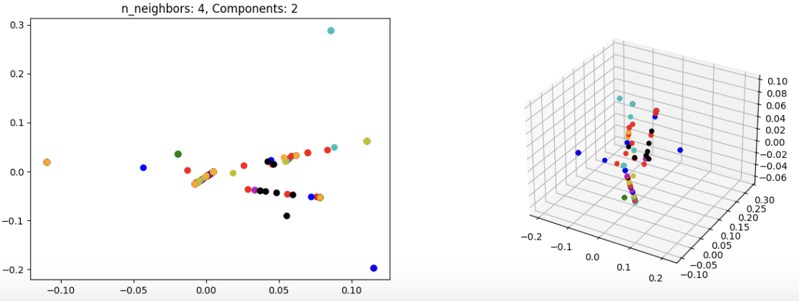
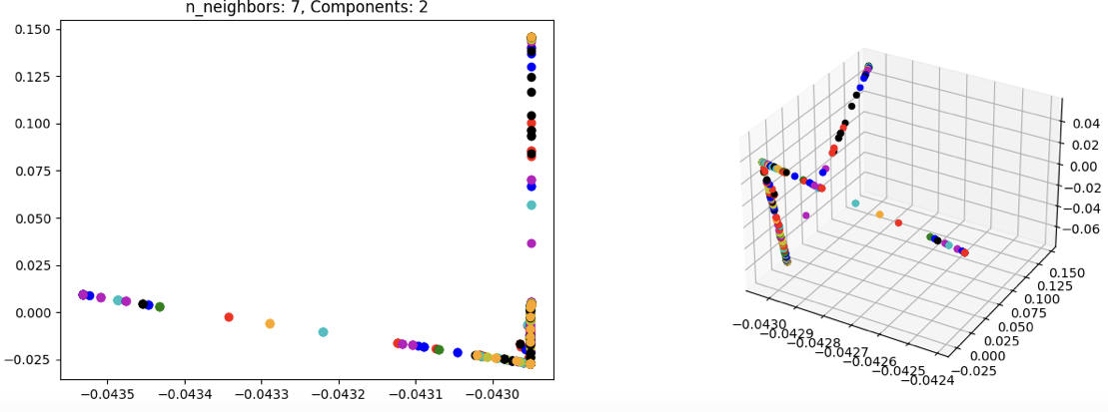
Locally Linear Embeddings
Parameters:
n_neighbors = 1: Data points are spread out with overlap, suggesting too few neighbors to maintain structure.
n_neighbors = 4: More defined structure and clearer clusters, likely near-optimal neighborhood size.
n_neighbors = 7: Very tight clusters but potential overfitting to noise.
Clusters: LLE embeddings suggests that a small n_neighbors setting distincts data clusters with well-preserved local geometries, while both extreme low and high settings lead to underfitting and potential overfitting.
Notes:
(LLE) is a non-linear dimensionality reduction technique useful for unraveling the intrinsic geometry of high-dimensional data. Purpose is particularly adept at preserving the local structure of data and often used for exploring complex datasets and preparing them for tasks like classification or anomaly detection.

Slide 27
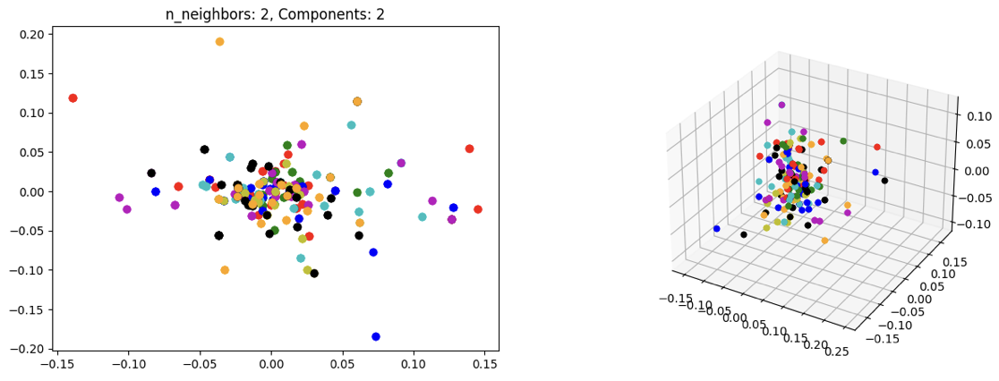
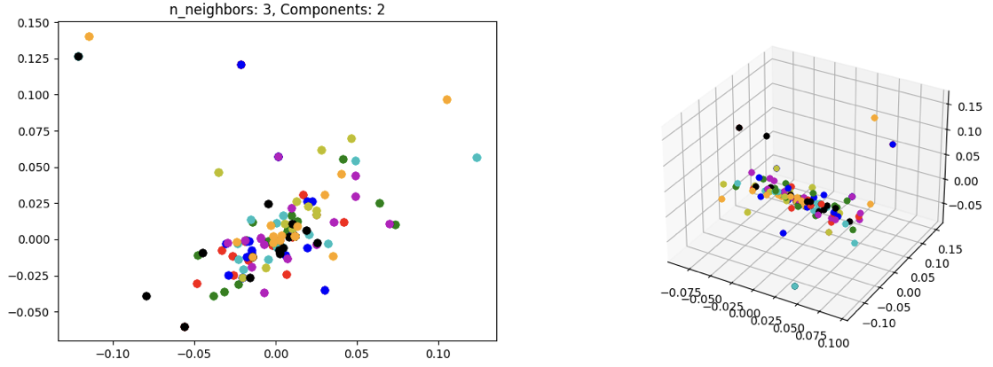
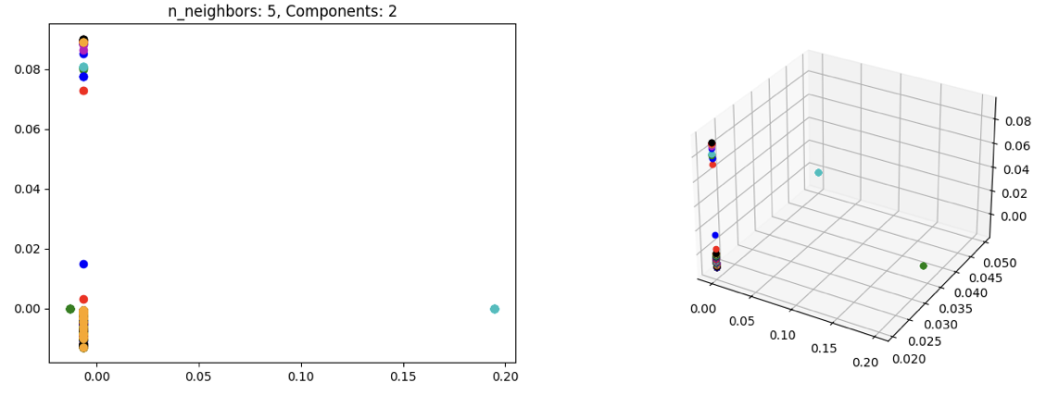
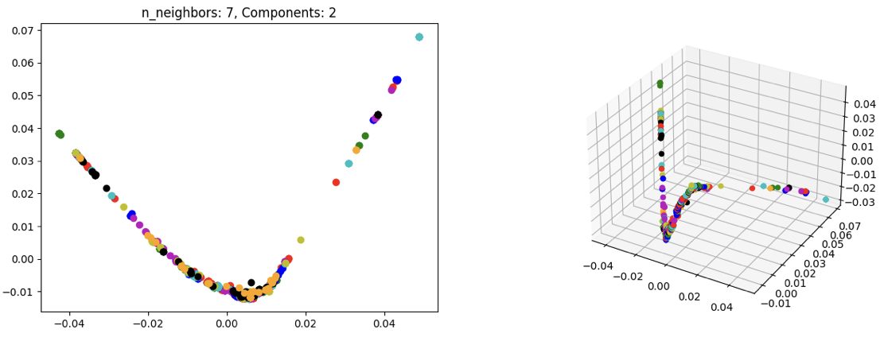
Spectral Embedding
n_neighbors=2: Clusters are forming but not cleanly separated in both plot
n_neighbors=3: Both 2D and 3D show a curving pattern, revealing a more defined data manifold with emerging geometric shape.
n_neighbors=5 & 7: Progressively smoother transitions from 2D to 3D plots reveal a complex, possibly processed the manifold.
Clusters: Suggesting that increase neighbors reveal curving manifolds in both 2D and 3D and the lager n_neighbors refines the smoothness and complexity of the manifold. Smaller neighbors

Slide 28
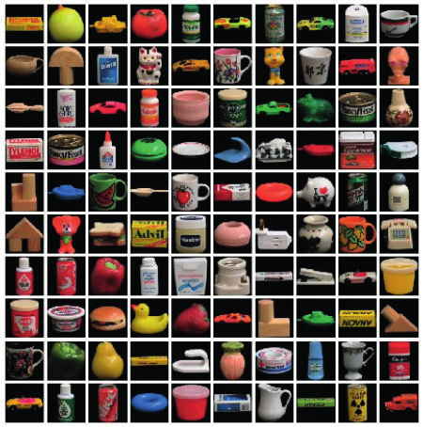
Coil-100

Slide 29
Dataset
Data Description:
Nature: Images of 100 different objects taken at various angles.
Format: Color images, typically stored as arrays.
Resolution: Originally varied; resized to 224x224 pixels.
Dataset Composition:
Total Data Points: 7,200 images (72 images per object).
Number of Classes: 100 (each class corresponds to an object).
Type of Classes: Object labels by number.
Points per Class: 72 images per object.

Slide 30
Data processing
Grouping: Organized images by object number for labeling.
Conversion to Grayscale: Simplified the data by removing color information, reducing computational complexity.
Resizing: Standardized image size to 224x224 for uniformity across the dataset, necessary for many machine learning models.

Slide 31
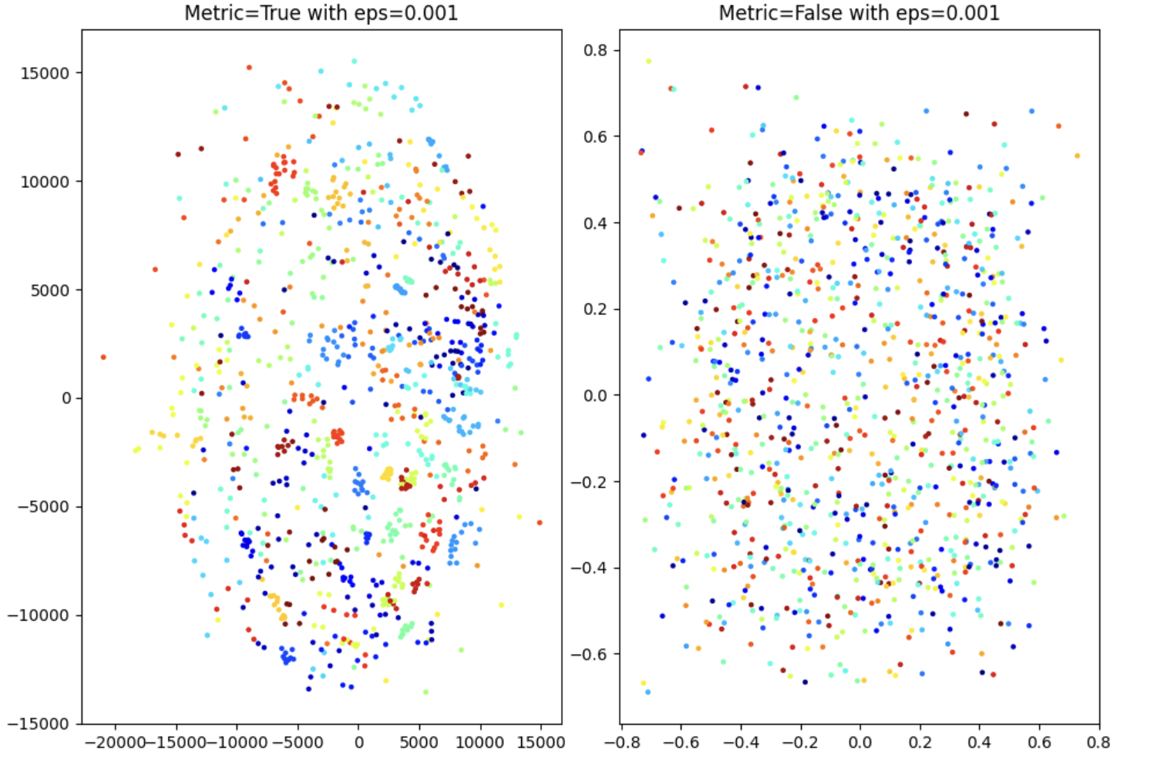
MDS

Slide 32
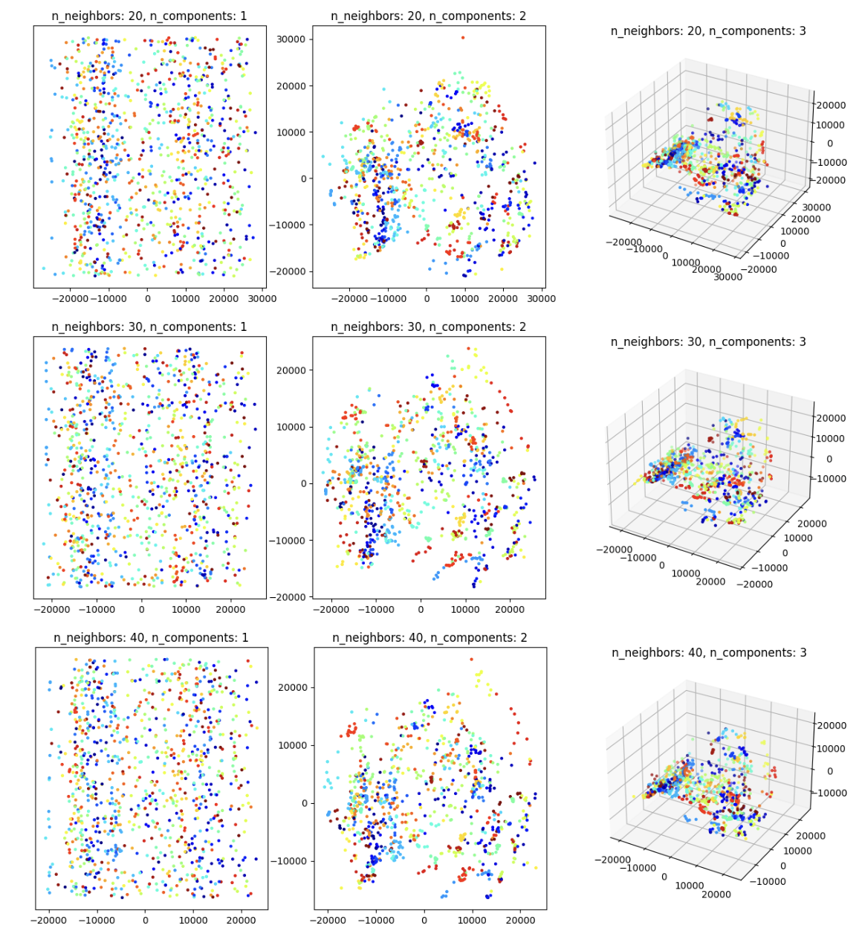
ISO-Map

Slide 33
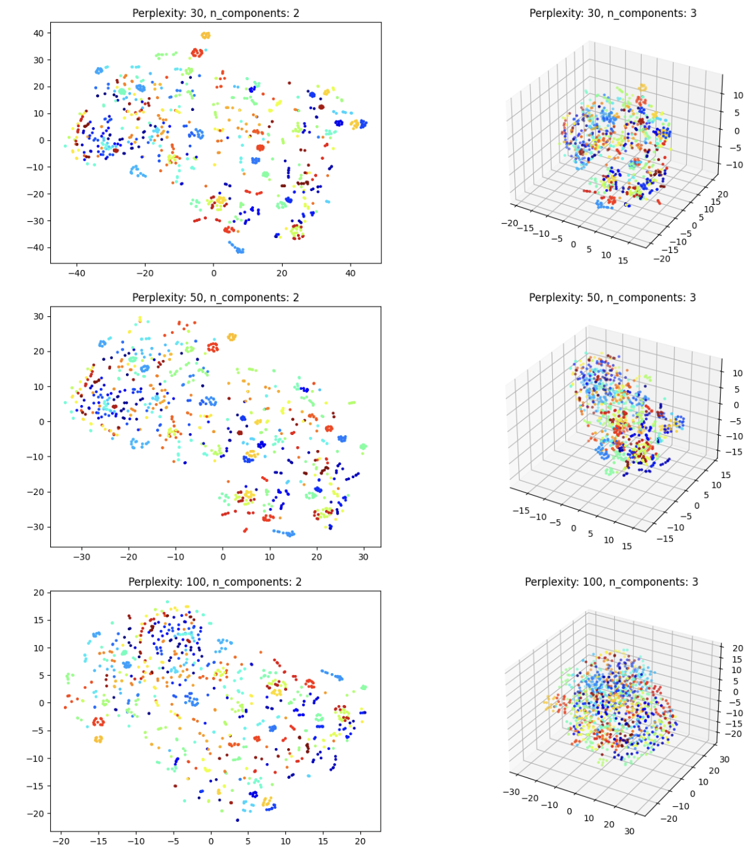
t-SNE

Slide 34
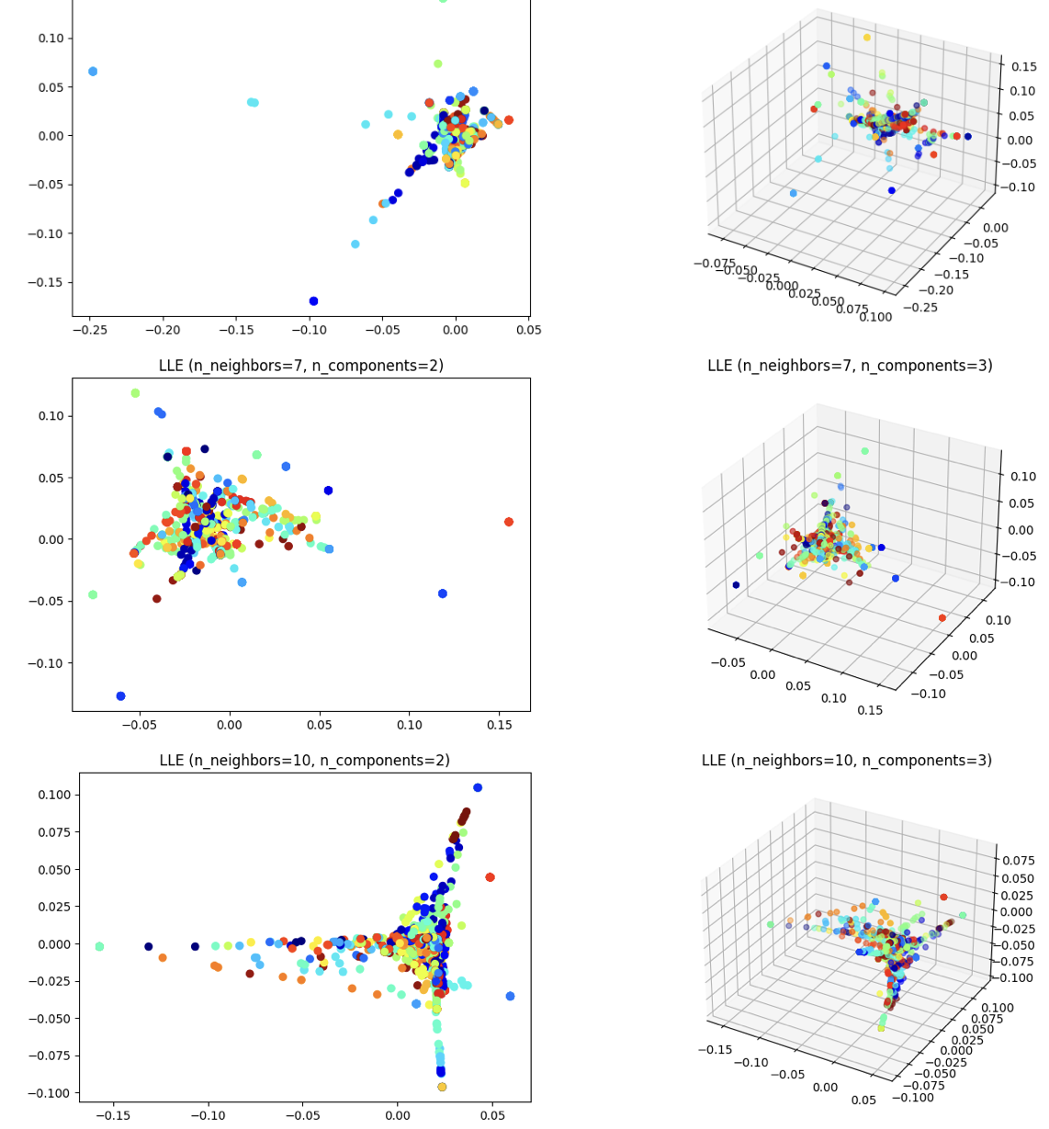
Locally Linear Embedding

Slide 35
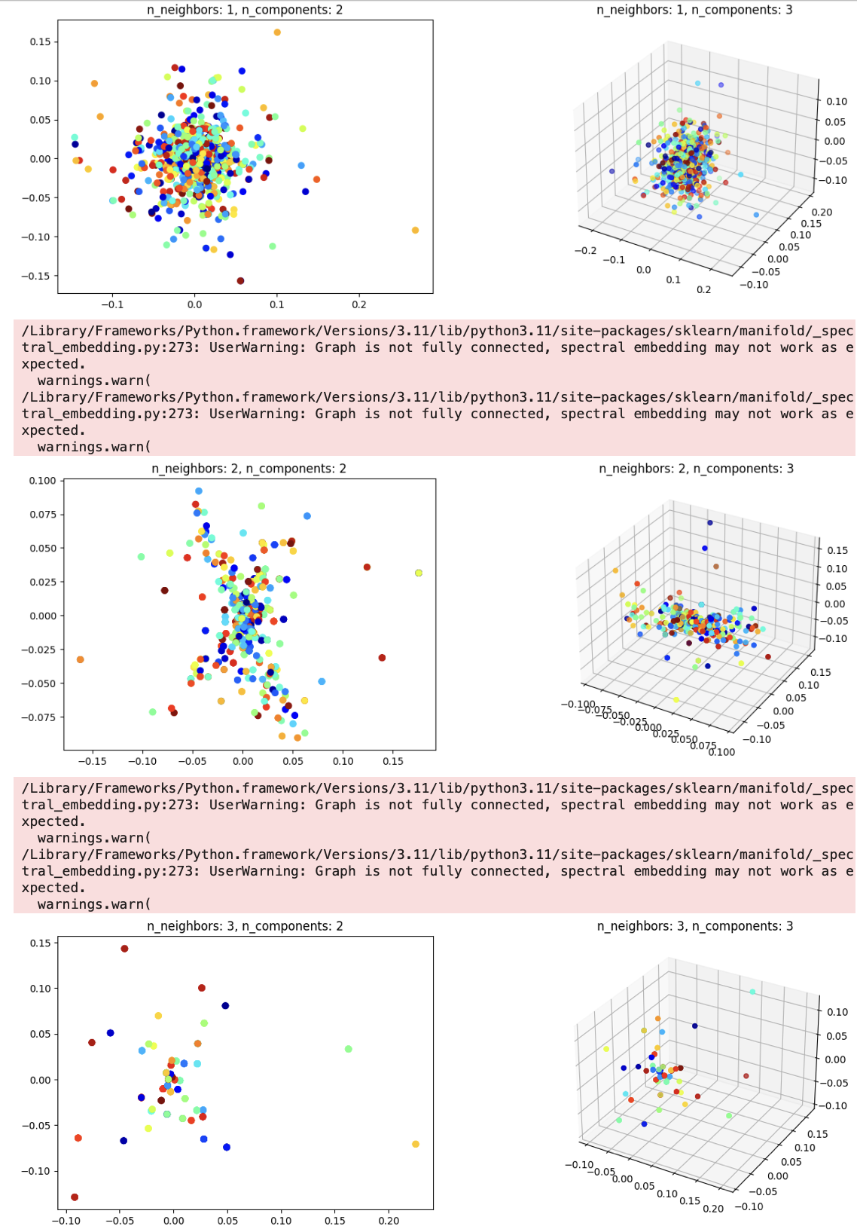
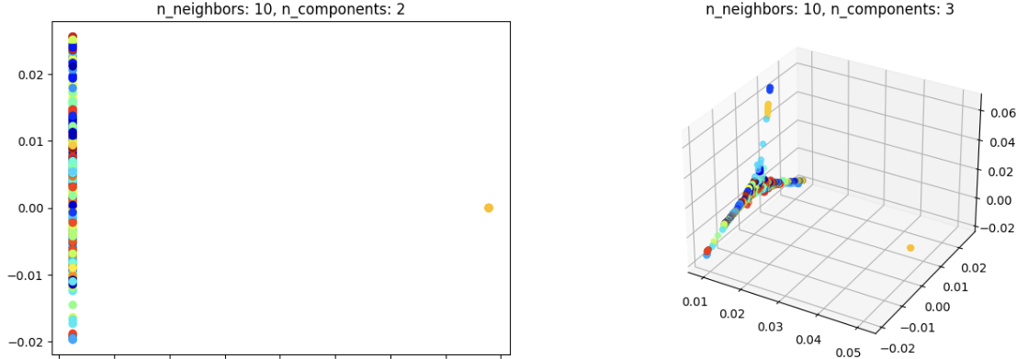
Spectral Embedding

Slide 36
Challenges and Problem solving
Large dataset sizes led to extensive computation times for manifold embeddings like MDS and Iso-map.
Solution: A smaller sample of the data was used for efficient embedding.
The similarity in image resolutions resulted in clusters that were not distinctly separated for some datasets.

Slide 37
Future Work
Coverting the cloudpoints set up to all the images from each of the datasets.
Then Applying the Wassmap embeddings
Using Dr Hamm’s code to do the clusters testing to test how well the cluster transform in the dataset

